Slide 1
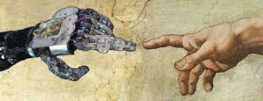
Artificial agents: creativity, moral agency and responsibility

Slide 2
Content
Artificial creativity
Artificial moral agents
Responsibility of artificial agents

Slide 3
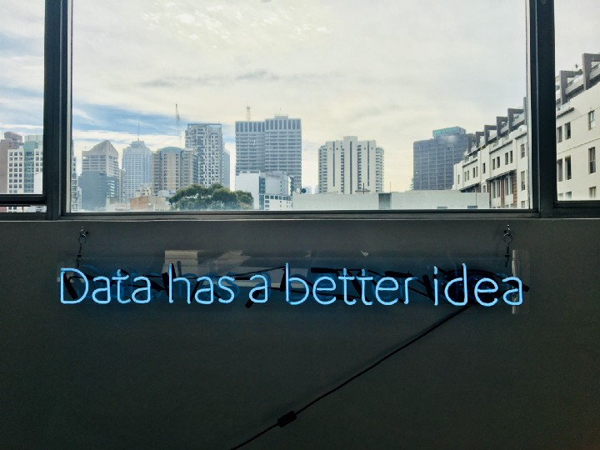
Artificial creativity
https://medium.com/swlh/gpt-3-the-ai-writing-tool-every-writer-needs-43b22638a18d

Slide 4
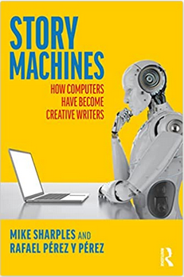
AI-generated writing (GPT-3)
“We have all read stories that have been written by software. They are just not labelled as such. Perhaps the most well-known are the choose-your-own-adventure books where readers are given a series of choices and are instructed to turn to a certain page for the next chapter. For the most part, the stories are successful because they are written in a way that allows each person to feel as if they are the protagonist who is making the decisions. But these are just the beginnings of what’s to come. Imagine what would happen if the machines that create these stories also became able to write original content. What would that mean for the way in which the stories are conceived, the way in which they are written, and the way in which they are read?
We didn’t compose that first paragraph – a computer did. We instructed it to “Write the opening paragraph for a book about the effect on people and society of computers that generate stories”, then copied and pasted the result (it generated five versions and we chose the best).”
Sharples, Mike; Pérez y Pérez, Rafael (2022). Story Machines: How Computers Have Become Creative Writers (p. xi), Routledge.

Slide 5
Text generation: benefits and challenges
Speed of text creation
Low costs
Some specialised, some highly versatile regarding formats and styles
Good at paraphrasing and summarising
Use for brainstorming
Requires human oversight and editing
Content not entirely reliable (source and flow)
(https://robotwritersai.com/ai-text-generator/)
Replacement of human writers?

Slide 6
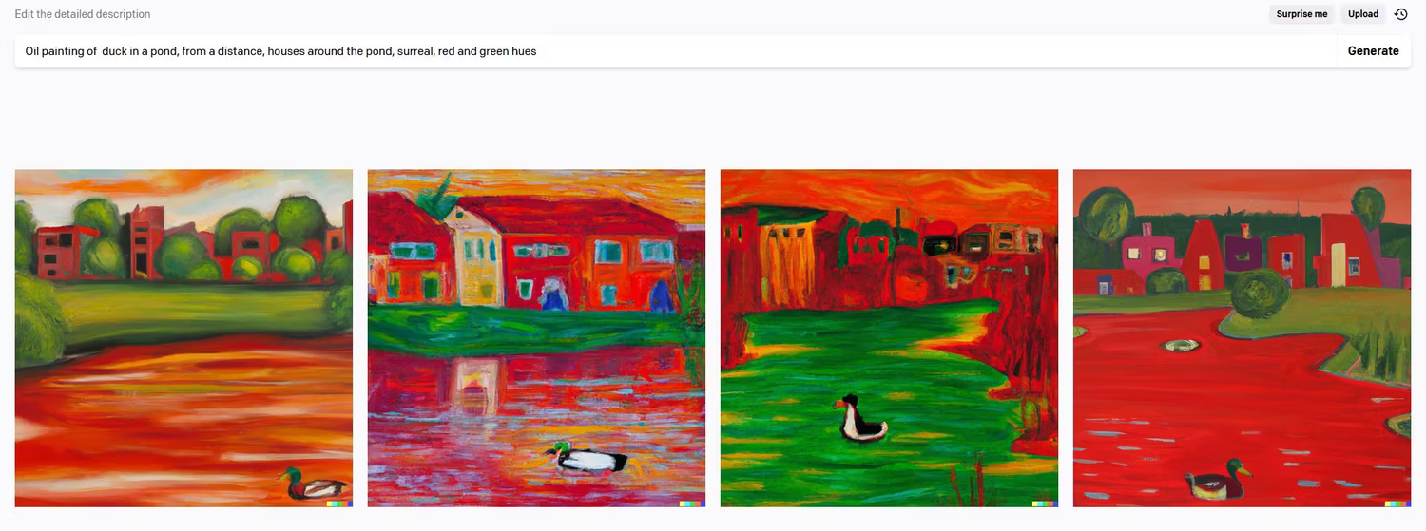

AI-generated images (DALL-E)

Slide 7
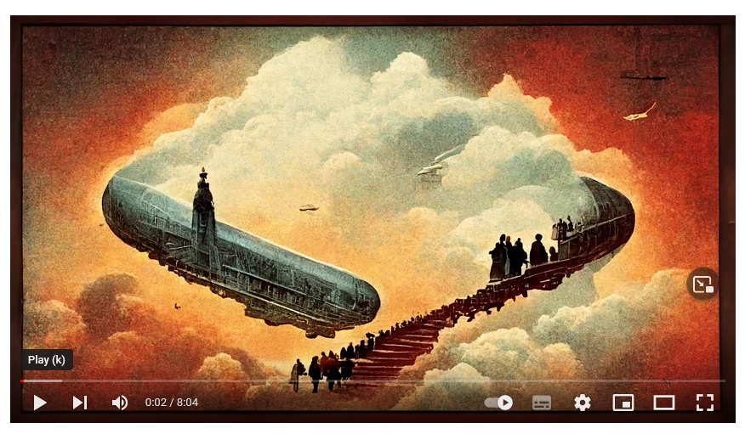
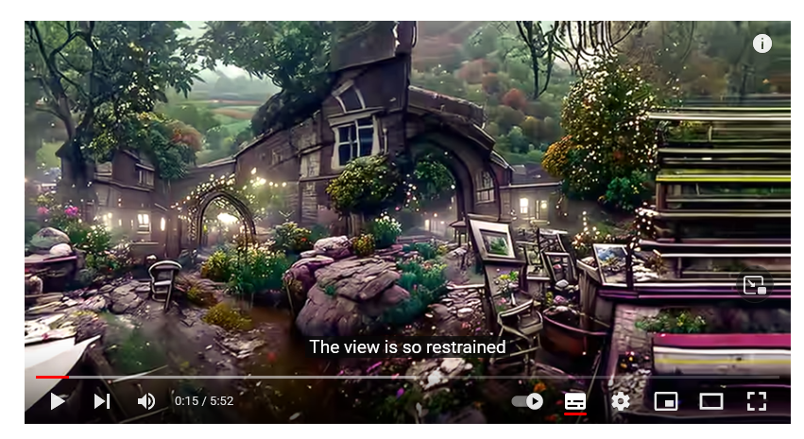
AI generated music videos
Images generated on the basis of song lyrics
(e.g. Led Zeppelin “Stairway to heaven”) https://www.youtube.com/watch?v=ZCKdPhepB1s
Animated video generated on the basis of song lyrics
https://www.youtube.com/watch?v=0fDJXmqdN-A

Slide 8
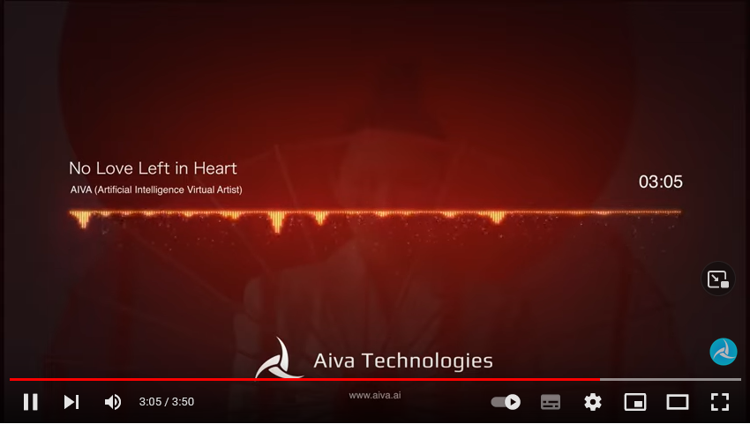
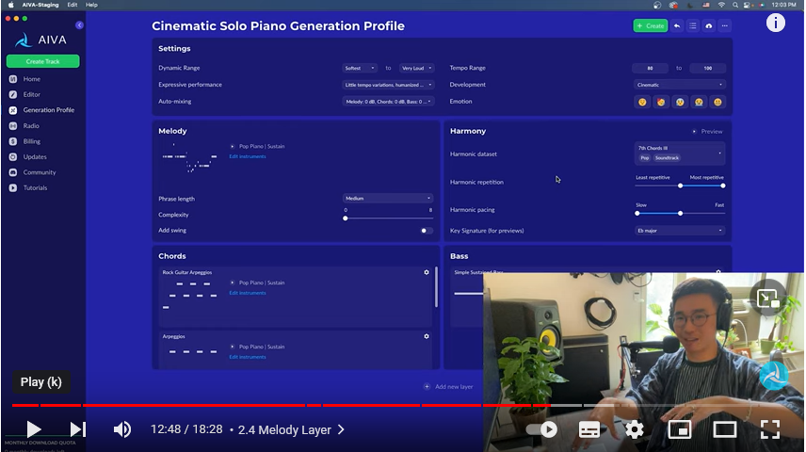
AI-generated music
AIVA: “No love left in heart” (2022)
https://www.youtube.com/watch?v=hTXFfHr8mUk
Process of generation of cinematic solo piano tune on AIVA (2022)
https://www.youtube.com/watch?v=LbKB4Tr2kHw

Slide 9
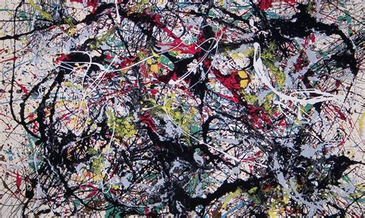
Comparison AI art and human art
Creativity: Is AI generation of art creative in the true sense?
Pro AI creativity: creating genuinely new, often surprising outputs; human creativity similar to AI creativity in relying on and building up on extensive background information
Pro Human creativity: distinctive role of the programmer and user of AI art generation systems in defining system’s capabilities and consciously working with it vs AI system itself (AI as medium, similar to photography?)
Artist’s intention/expression: Product alone does not seem sufficient
Does art require a conscious expressive intention, relation to social meaning, and recognition as such in social context? (i.e. would AI have to be conscious to create art?)

Slide 10
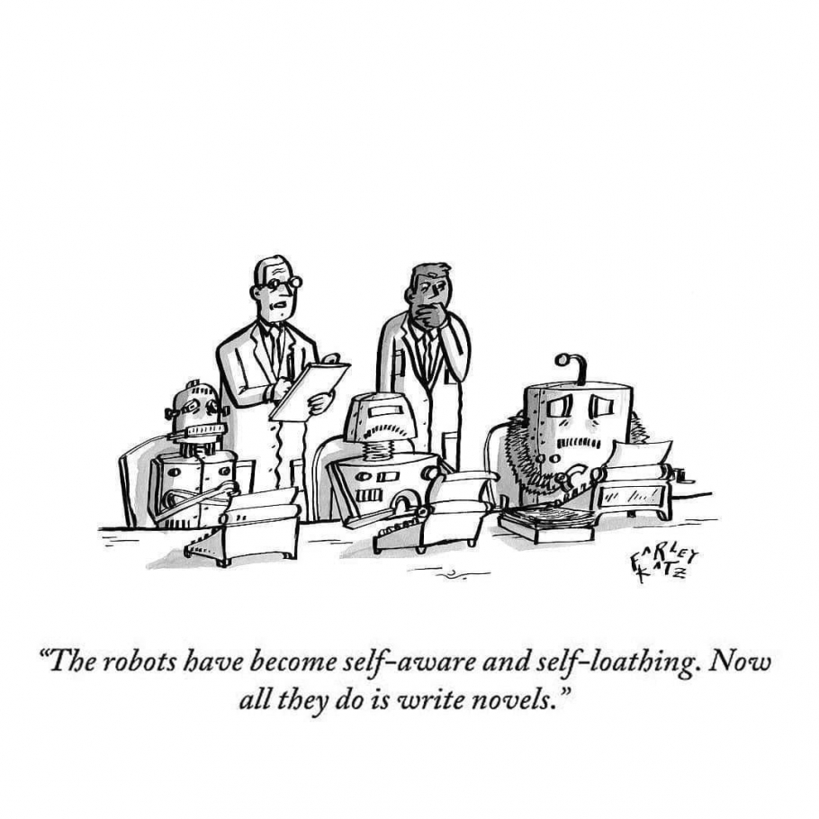
https://www.creativindie.com/can-ai-writing-software-create-fiction-this-was-written-by-robots/
(probably a New Yorker cartoon originally)

Slide 11

Artificial moral agency

Slide 12
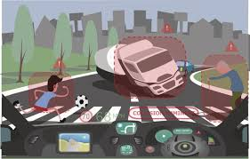
Self driving cars and decision-making
Self driving cars need to be designed to react appropriately to a complex set of hazards in natural driving environments.
For a situation like the one above, what considerations need to be taken into account in determining the car’s reaction to the situation?
Is a self-driving car an artificial moral agent? Why/why not?

Slide 13
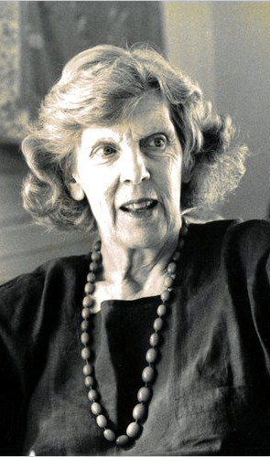
The Trolley Problem
Philosophical thought experiment by Philippa Foot:
You see a runaway trolley moving toward five tied-up people lying on the main track. You are standing next to a lever that controls a switch. If you pull the lever, the trolley will be redirected onto a side track, and the five people on the main track will be saved. However, there is a single person lying on the side track. You have two options:
Do nothing and allow the trolley to kill the five people on the main track.
Pull the lever, diverting the trolley onto the side track where it will kill one person.
What is the right thing to do?

Slide 14
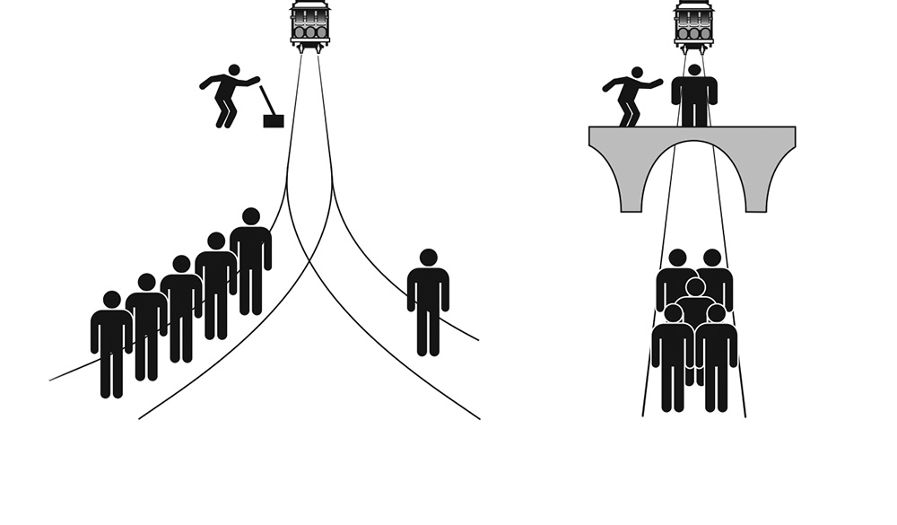
Self driving cars as solvers of moral “trolley problems”?

Slide 15
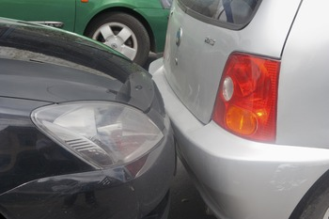
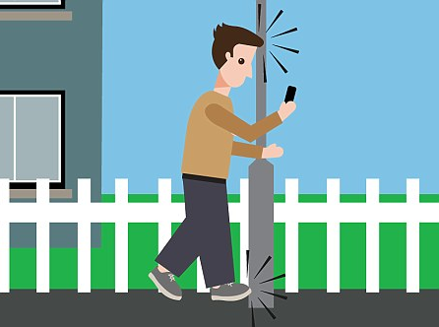
Or just sophisticated „do not bump into objects“ machines?

Slide 16
Moor (2006) Categories of moral agents
ethical impact agents: technologies that have an ethical impact (e.g. using robots instead of slaves)
implicit ethical agents: the technology’s construction constrains specified behaviour that impacts on ethical parameters (e.g. safety software)
explicit ethical agents: technologies that represent ethical categories and perform ethical analysis resulting in moral judgments (e.g. ethics as skill understood in analogy to chess playing)
full ethical agents: fulfills 3., but potentially additional characteristics required, such as consciousness, intentionality, free will

Slide 17
Wallach & Allen (2010) regarding implicit moral agents
the decision-making capabilities of such systems do not involve any explicit representation of moral reasoning.
the sensory capacities of these systems are not tuned to ethically relevant features of the world.
“A breathalyzer-equipped car might prevent you from starting it, but it cannot tell whether you are bleeding to death in the process. Nor can it appreciate the moral significance of its refusal to start the engine.”

Slide 18
Wallach & Allen (2012): 3 classes of moral agency
operational morality: Systems with very limited autonomy and sensitivity, their moral use is entirely in the hands of designers and users
functional morality: more sophisticated technologies, where the machines themselves have the capacity for assessing and responding to moral challenges.
full moral agency: genuine moral agency with responsibilities and rights, comparable to those of humans

Slide 19
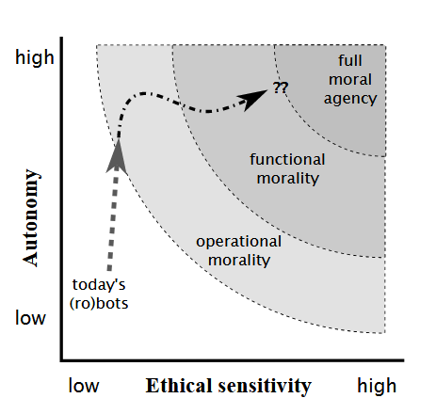
Wallach & Allen (2012)

Slide 20
Floridi & Sanders (2004): characteristics of moral agents
Interactivity
influences, and is influenced by, the environment
Autonomy
modifies its internal states by itself, to some extent independently from environmental stimuli
Adaptability
changes its ways according to its past performances
Ability to cause moral effects.
generates effects that may be morally assessed as good or evil

Slide 21
Wallach & Allen (2012): Implementing moral capacities in machines
the top-down imposition of an ethical theory, i.e. programming the ethical theory into the machine
Challenge: “moral judgement”, i.e. application to real life situations, especially interpretation of relevant background information
the bottom-up building of systems, attempting to emulate learning, developmental and evolutionary processes,
Challenge: safeguards against learning or evolving bad behaviours and norms
The mix of bottom up and top-down approaches in a system modelled on virtue ethical approaches (e.g. training via neural network models)

Slide 22
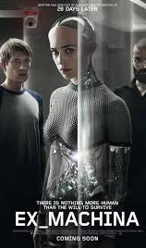
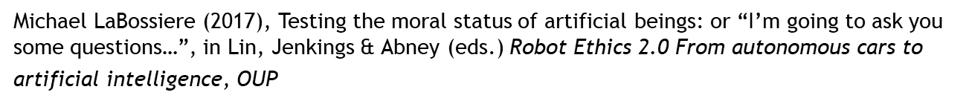
The “moral turing test” (LaBossiere 2017)
A technology is a moral agent if they can pass the “moral Turing test”, i.e. a human observer would not be able to tell the difference between moral communications by humans and the technology
Test of reason & feeling for the moral domain
Problem: Is the ability to make moral utterances sufficient? E.g. Ava in Ex Machina would pass the test, but is shown not to be bound by human moral norms (manipulating and killing human interlocutors)

Slide 23
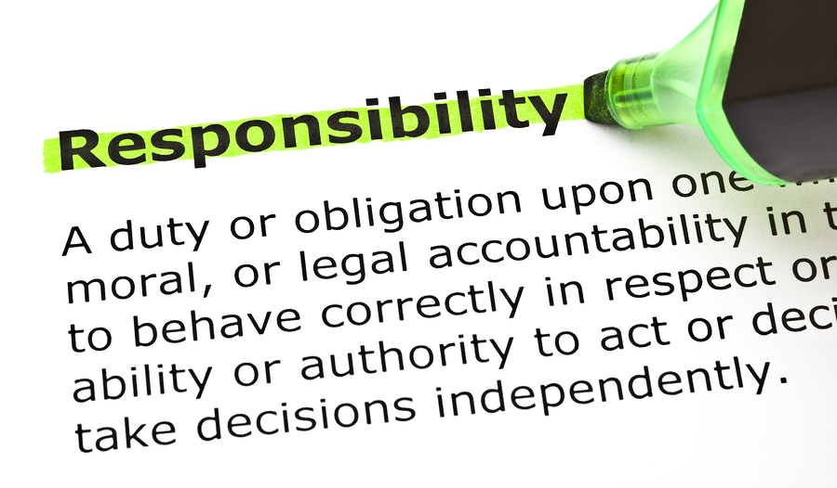
Responsibility of artificial agents

Slide 24
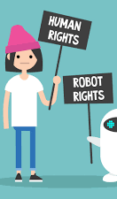

Should artificial agents get rights?
European Parliament Committee on Legal Affairs stated in 2017 that under certain circumstances robots need to be assigned personhood, with associated rights
Mady Delvaux (rapporteur for committee): “If I create a robot, and that robot creates something that could be patented, should I own that patent or should the robot? If I sell the robot, should the intellectual property it has developed go with it?” (Guardian, January 12, 2017, https://www.theguardian.com/technology/2017/jan/12/give-robots-personhood-status-eu-committee-argues )

Slide 25
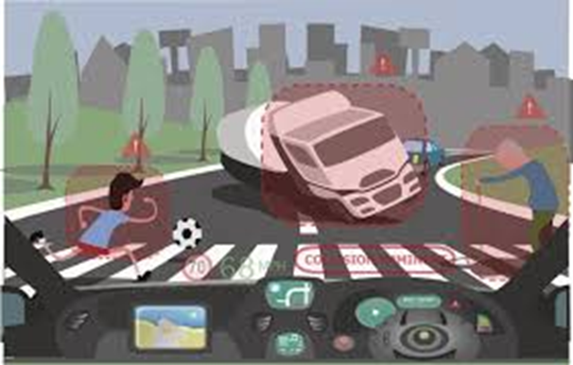
Responsibility of artificial agents?
Case A: Louise braked but hit the boy with the football, resulting in serious injuries
Under what circumstances would Louise be responsible for the accident? Under which circumstances would she not be considered responsible for what happened?
Case B: The self-driving care braked but hit the boy with the football resulting in serious injuries.
Could the self-driving car be considered responsible, who else would count as responsible? What characteristics would be needed for the car to be seen as responsible?

Slide 26
Responsibility
Linked to the ability of independent or autonomous agency of the agent
Requires good understanding of context within which agent operates
Requires ability to make decisions that integrate complex inputs
Excuses based on specific limitations of the decision process
Good intentions
Non-culpable lack/lapse of knowledge
Coercive context (no obviously better choice available)

Slide 27
The role of knowledge
Moral responsibility depends on understanding the nature of what one does
Different reasons for lack of understanding:
Not understanding action itself
Not understanding circumstances
Not understanding demands of morality

Slide 28
Responsibility and retribution
If a wrong is done, humans want to identify a “culpable wrongdoer who is deserving of punishment”
Challenge: with increasing automation it is “likely that robots will be responsible for more and more harm and injury, but the robots themselves are unlikely to meet the conditions for retributive blame”
Command responsibility (i.e. those in command are responsible by definition) as sufficient solution?

Slide 29

Responsibility and the “retribution Gap” (Danaher 2016)
Increasing levels of automatization make it likely that AI/robots will be responsible for more and more harm and injury, but the AI/robots themselves are unlikely to meet the conditions for retributive blame. With increasing AI/robot autonomy it is also likely that manufacturers or programmers will not be appropriate subjects of blame (i.e. “command responsibility” does not apply to them).
A “retribution gap” results: people will be eager to find an appropriate subject of retributive punishment, but none will be found.

Slide 30
Distributive agency instead of independent agency? (Nyholm 2017)
1. Domain specific agency (basic): pursuing goals on the basis of representations, within certain limited domains
2. Domain specific agency (principled): pursuing goals on the basis of representations regulated and constrained by principles and rules, within certain limited domains
3. Domain specific supervised and deferential principled agency: as 2., but supervised and potential controlled by some authority (collaborative)
4. Domain specific responsible agency: as 2. but able to understand criticism and ability to defend or alter actions based on criticism
Claim: current AI/artificial agents fall under 3., not 4. – collaborative vis-à-vis supervising human operator and/or performance monitoring developers

